Slide 1
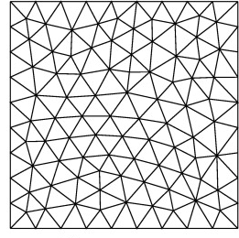
sensor location
nodes if influenceArea=0
+
nodes if influenceArea=1
+
+
nodes if influenceArea=12
Explanation of the parameter
influenceArea in ClosestPoints.py

